Slide 1


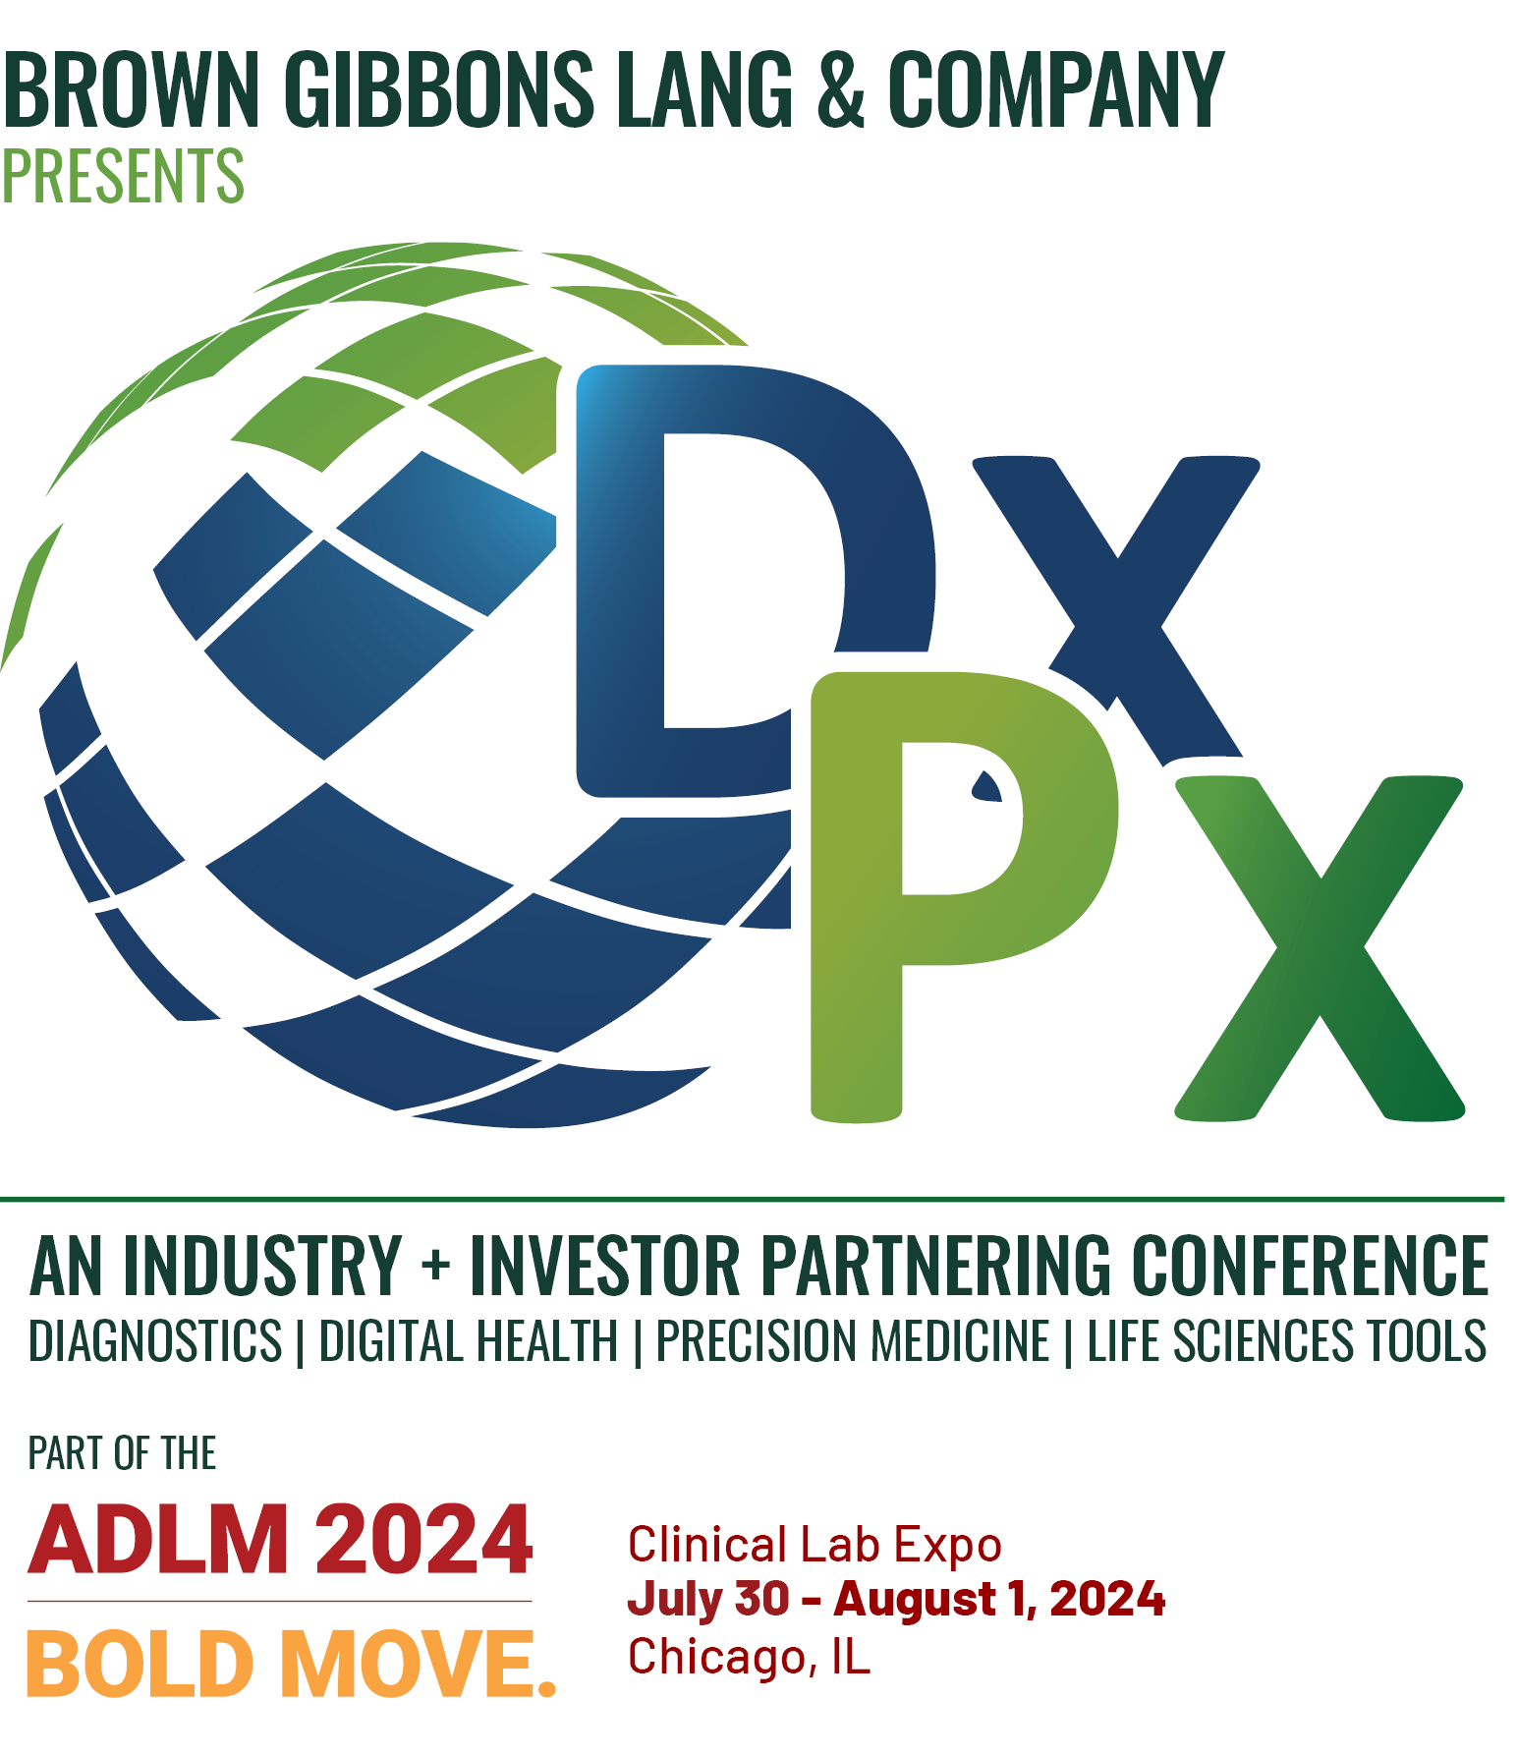


Conference Overview

Slide 2
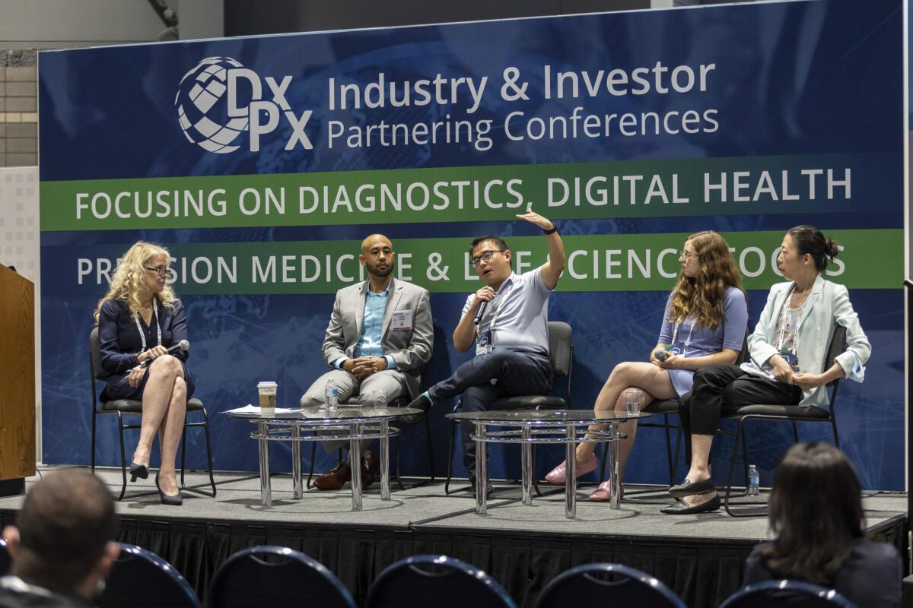
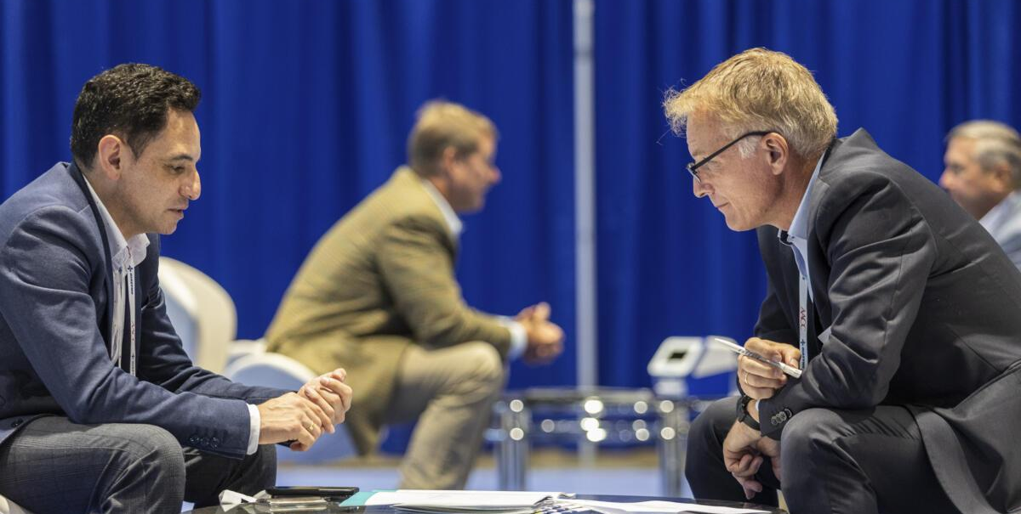
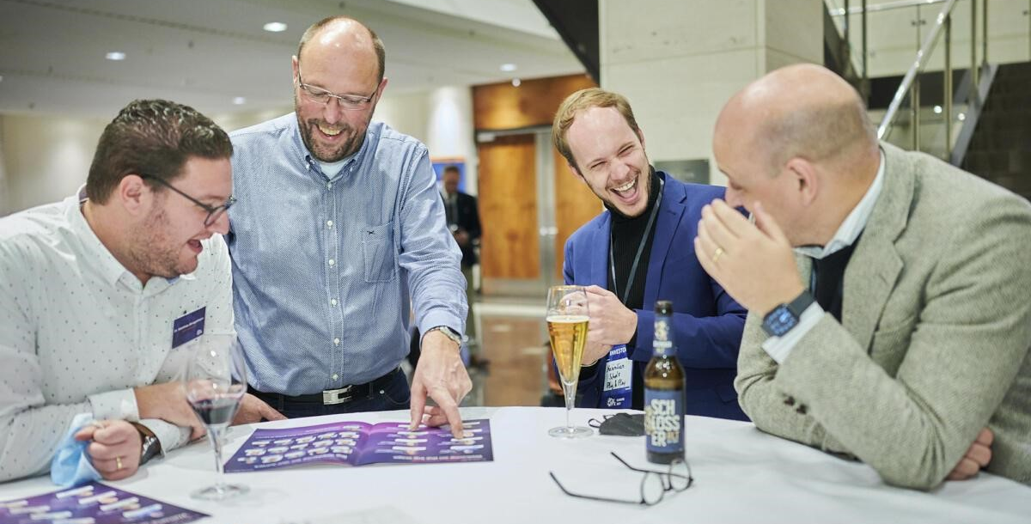

ABOUT DxPx U.S.
DxPx is an Industry + Investor Partnering Conference for the Diagnostics, Digital Health, Precision Medicine, and Life Science Tools industries.
DxPx U.S. is presented by Brown Gibbons Lang & Company (BGL), a leading independent investment banking and financial advisory firm.
DxPx U.S. is the place for startups and growth-stage companies to meet with investors and industry participants for licensing, financing, co-development, and M&A opportunities.
DxPx is also home to the 42PLUS1 Pitch Competition, which offers startups the chance to compete for up to $2 million in funding.

Slide 3

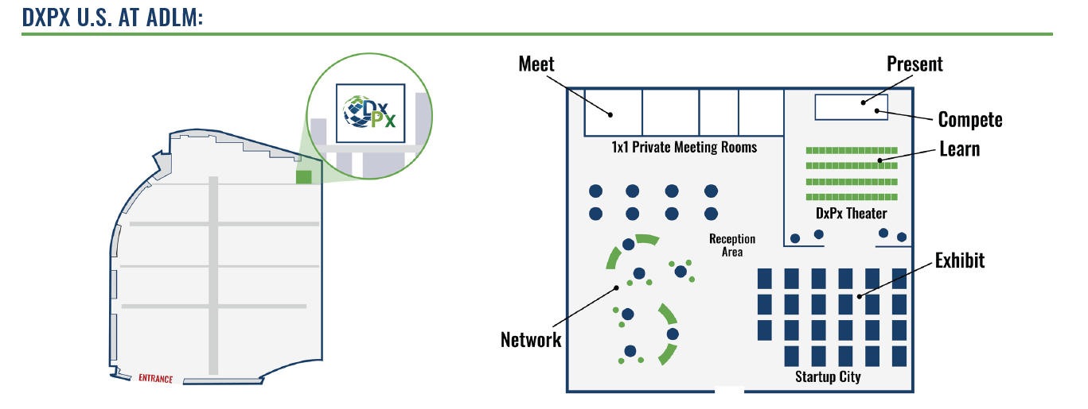
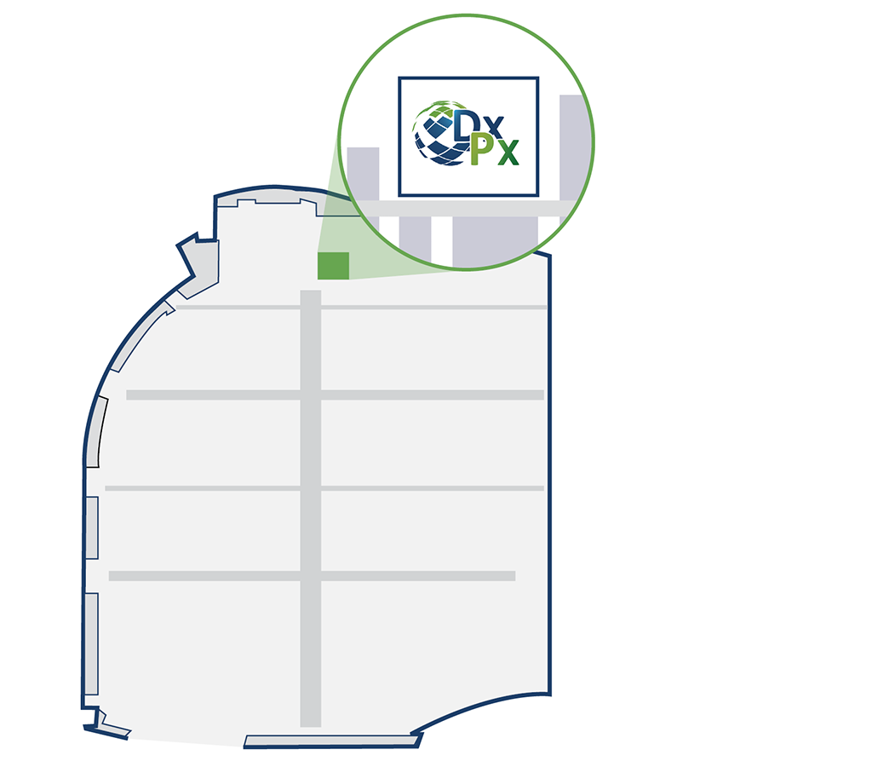
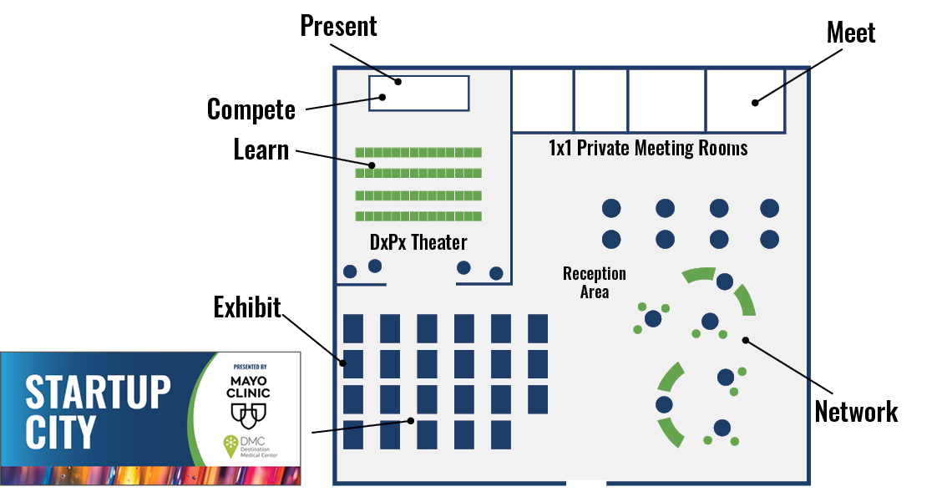
THE DxPx/ADLM PARTNERSHIP
With more than 900 exhibitors across 200+ product categories, the ADLM 2024 Clinical Lab Expo is the premier global laboratory medicine exposition.
DxPx U.S. is hosted within the ADLM 2024 Clinical Lab Expo, offering attendees an unparalleled opportunity for networking, partnering, and brand exposure.

Slide 4

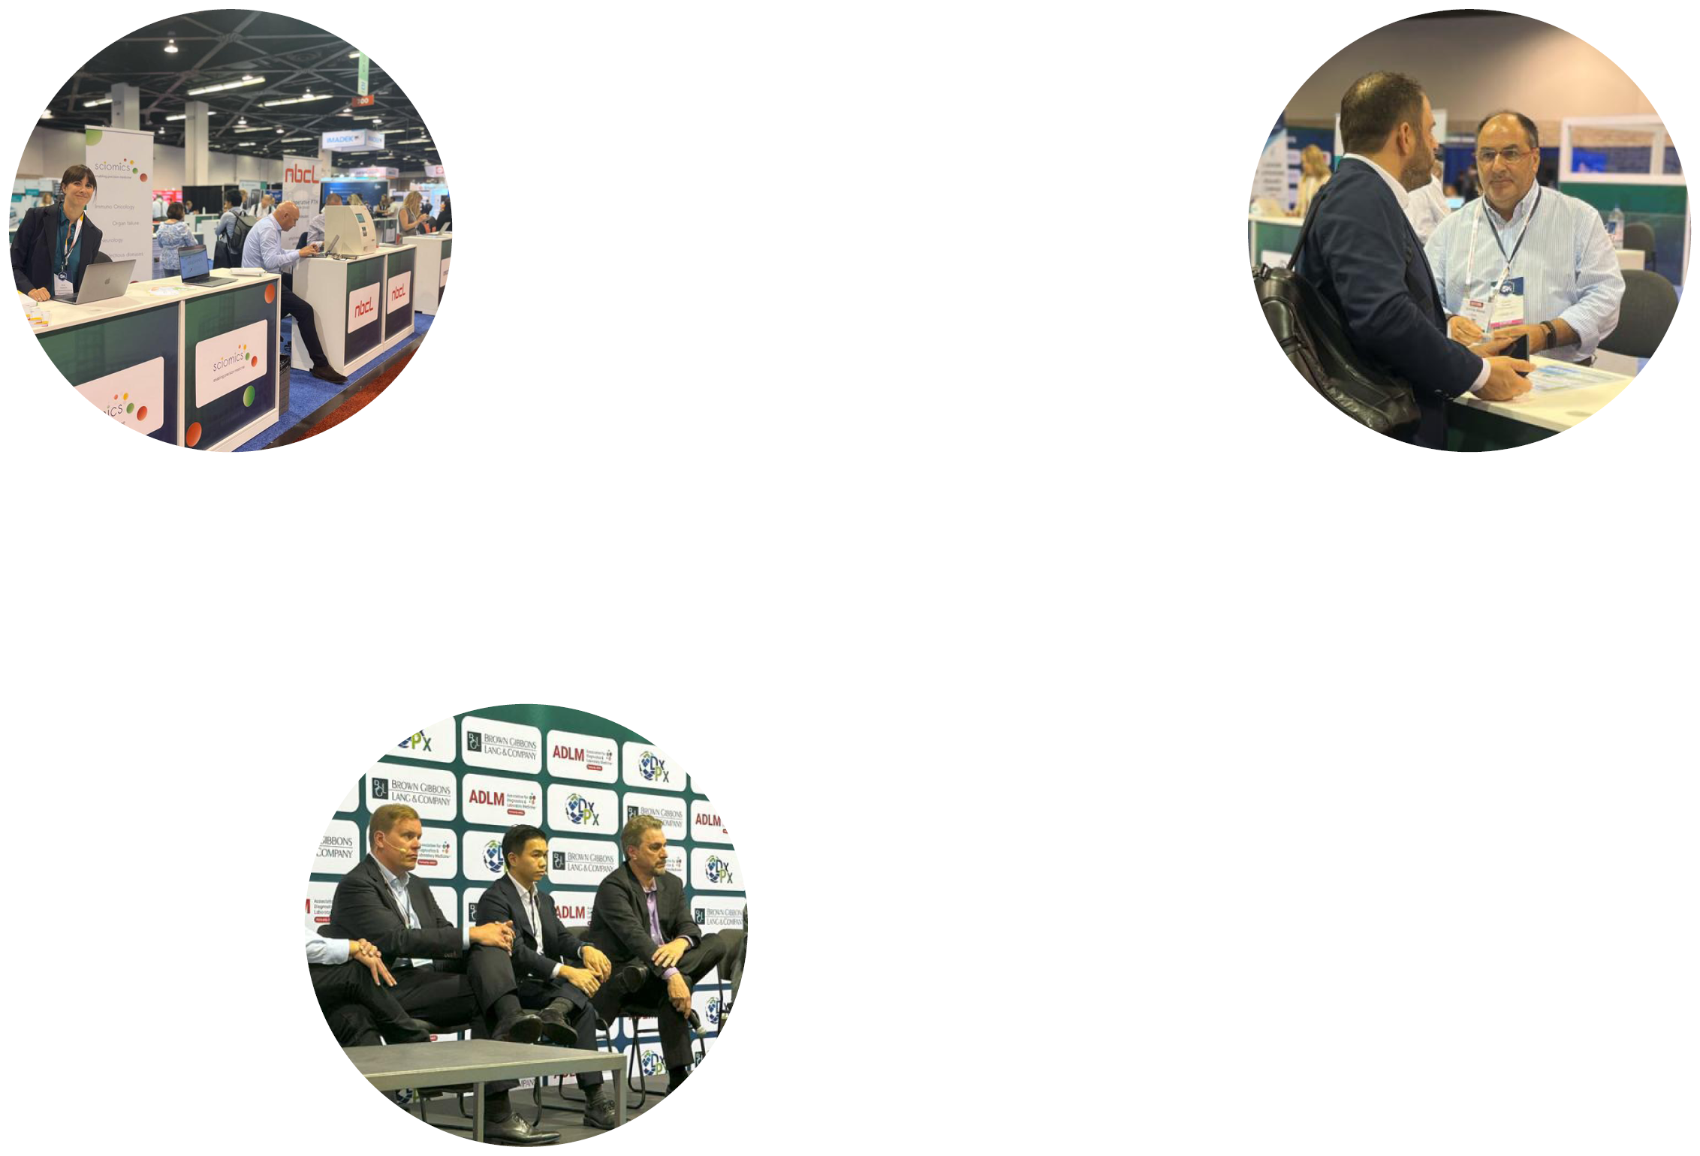
THE DxPx/ADLM PARTNERSHIP
ADLM is a Gold Sponsor of DxPx, enabling all attendees to get the most out of their time in Chicago this July:
All DxPx attendees receive a FREE registration for the ADLM 2024 Clinical Lab Expo
All ADLM 2024 Clinical Lab Expo Exhibitors receive a FREE registration for DxPx U.S.
AND
Investors, Accelerators, and Startups are also eligible for a FREE or discounted ticket to DxPx U.S.
Learn more on our website.

Slide 5
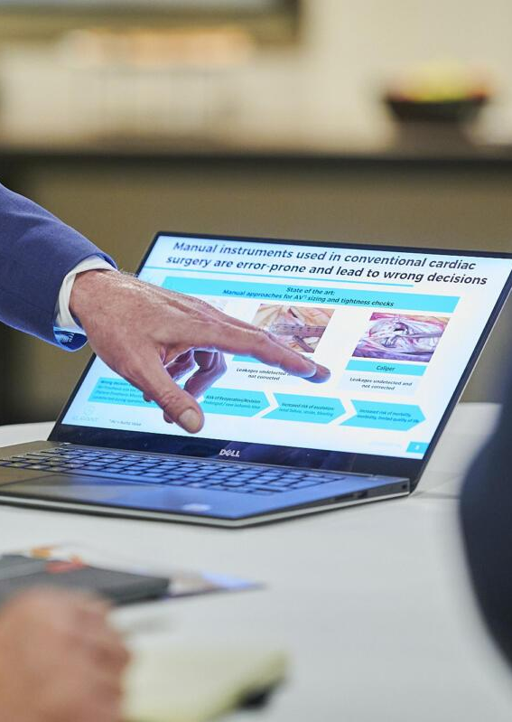





DxPx KEY BENEFITS
Pre-Scheduled 1x1 Meetings offer the ability to maximize your time at DxPx + ADLM 2024, including the use of our DxPx private meeting rooms
Exclusive Networking Events connect startups, growth-stage companies, investors & accelerators and their portfolio companies, tech scouts, service providers, and others
Key Benefits
Panel Presentations feature industry knowledge & market insights from leading healthcare industry experts and private equity investors
Startup City spotlights the most innovative HealthTech and MedTech startups exhibiting right from within ADLM 2024
42PLUS1 Pitch Competition gives eight startups the chance to present their business plans and compete for up to $2 million in funding

Slide 6
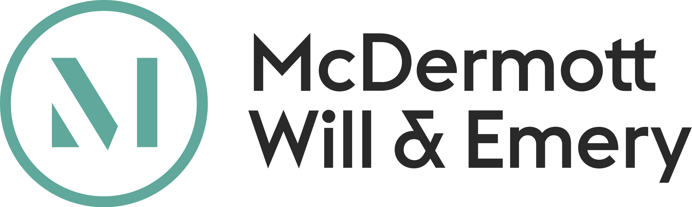
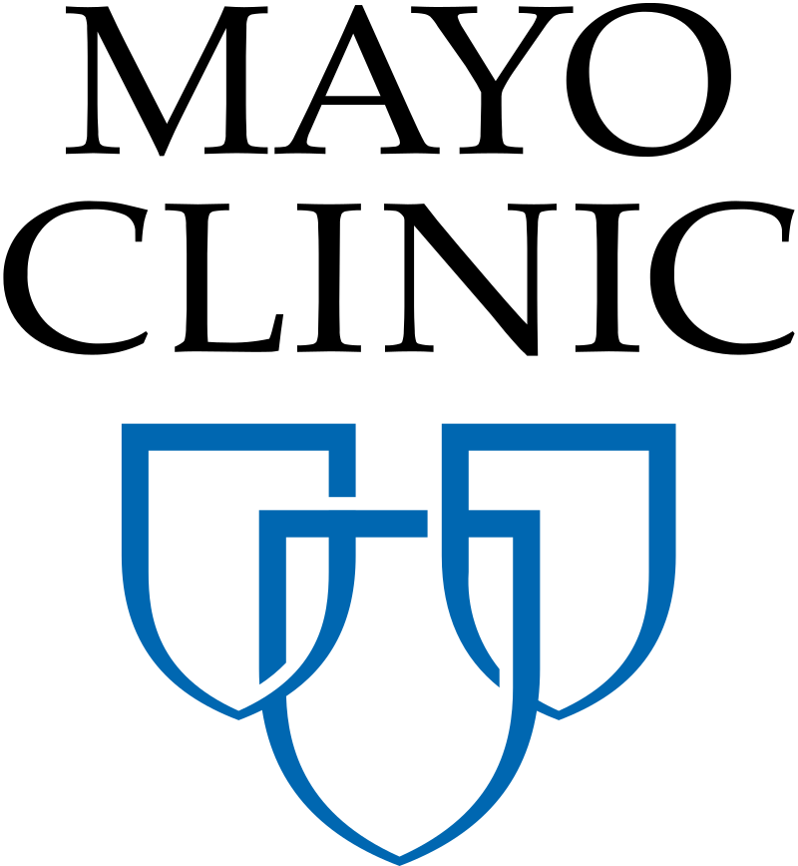





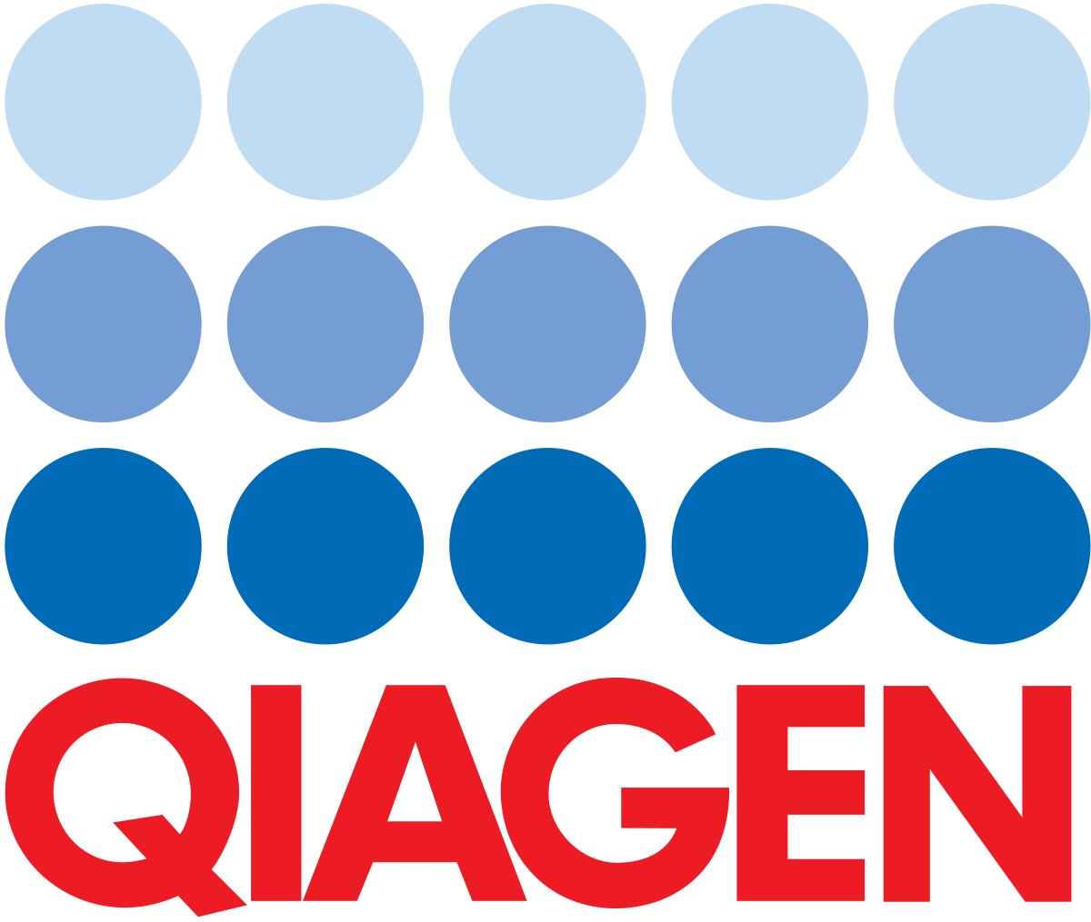

INDUSTRY SUPPORT
DxPx has enjoyed longtime support from several leading industry players:
BGL
SILVERSKY
DMC
HIGH-TECH

Slide 7
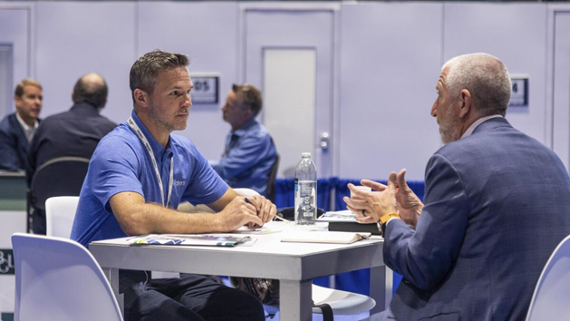
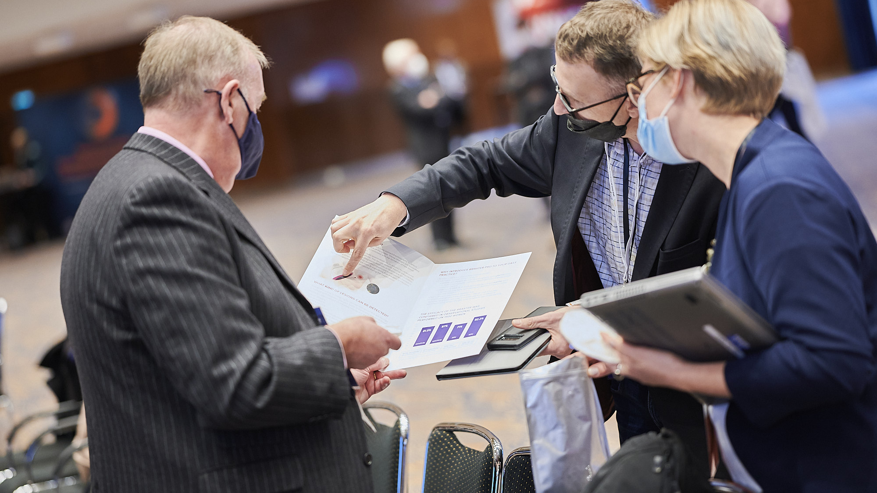
AMBASSADOR NETWORK
DxPx is building the industry’s leading HealthTech and MedTech ambassador network – and we want you to join us.
Ambassador Program Benefits:
Get up to three (3) FREE investor registrations for you and your colleagues.
Get one FREE startup registration for every five (5) portfolio companies* in the Diagnostics, Digital Health, Precision Medicine, and Life Sciences Tools industries you refer to DxPx U.S.
Enhance the visibility of your brand before and during the conference in DxPx U.S. promotional materials.
Ambassador Program Requirements:
Refer at least one (1) startup in your network each month to the 42PLUS1 Pitch Competition.**
Apply to be a judge for the 42PLUS1 Pitch Competition and review at least five (5) 42PLUS1 applications for the 2024 award cycle.
Post to your social media accounts at least one (1) time per month to help us promote DxPx U.S. and/or the 42PLUS1 Pitch Competition.
* Limit 5 free startup registrations per Ambassador.
** Startup must complete and submit an application to 42PLUS1.

Slide 8
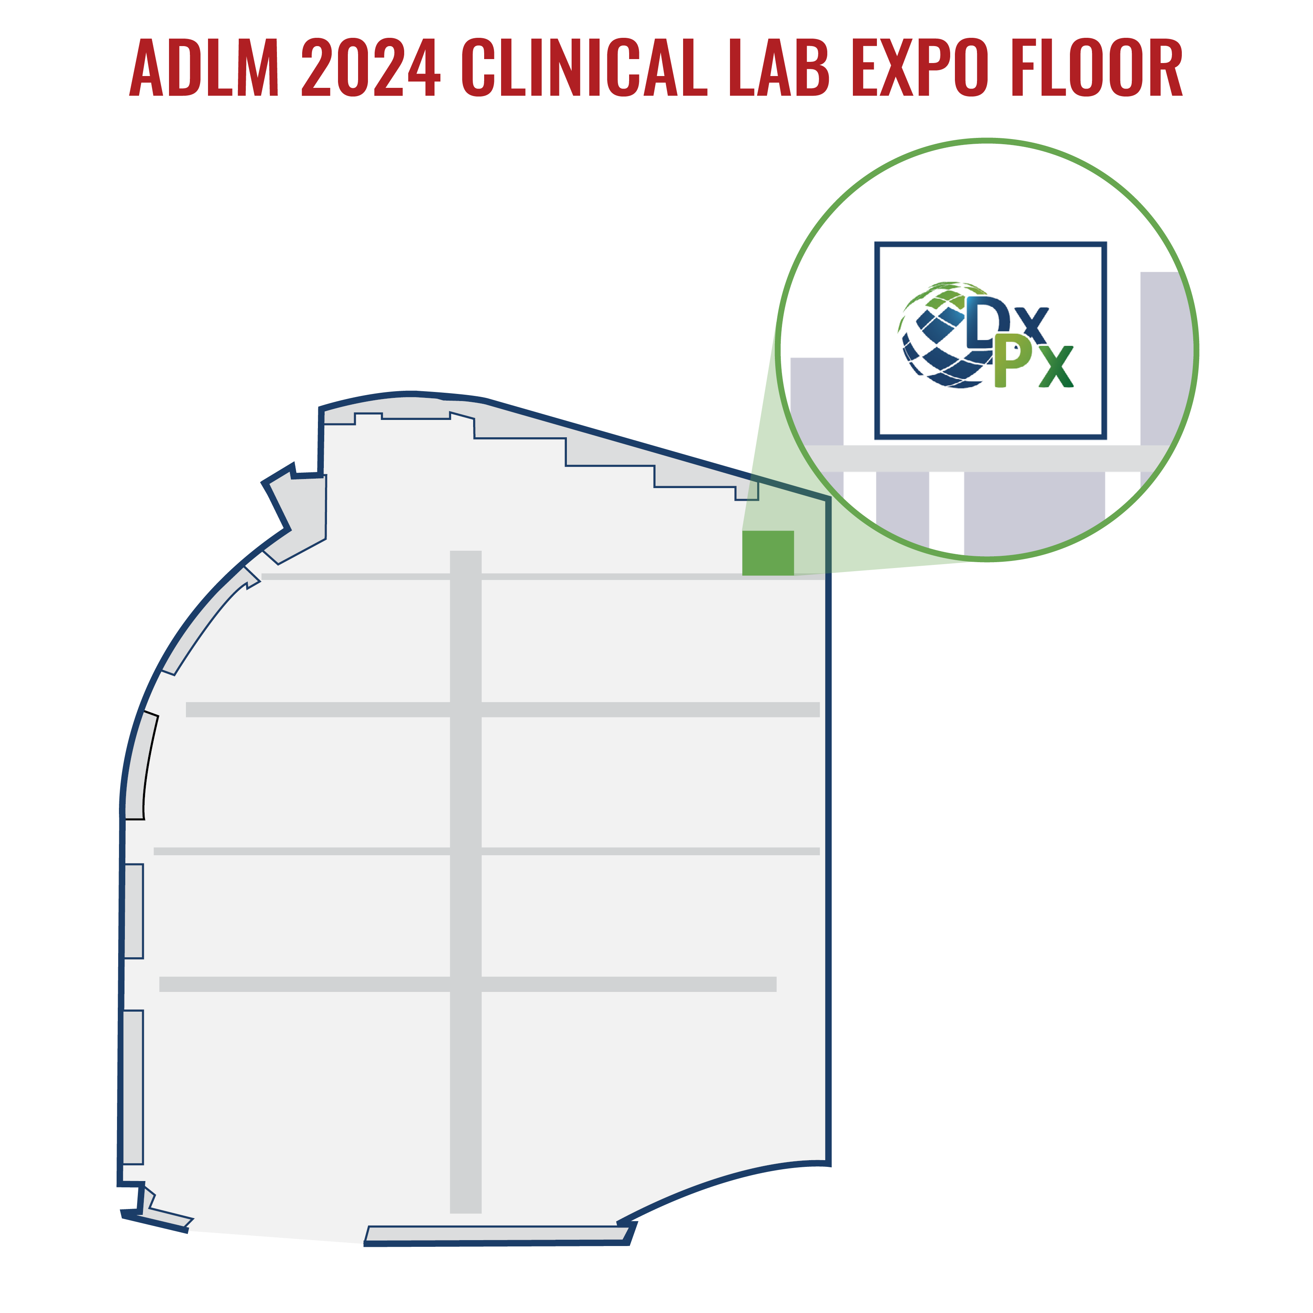
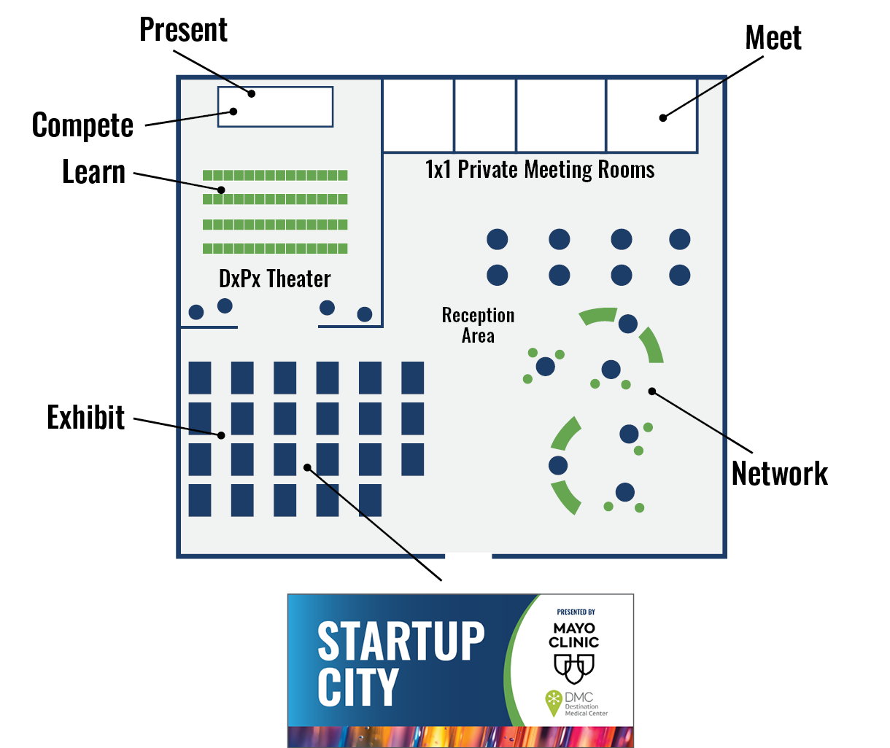
STARTUP CITY – PRESENTED BY MAYO CLINIC & DMC
Startup City provides startups with the best of both worlds:
The targeted early-stage investor audience offered by DxPx U.S.
The incredible brand exposure offered by the ADLM 2024 Clinical Lab Expo
+
Startup City is a unique exhibition opportunity for startups in Diagnostics, Digital Health, Precision Medicine & Life Science Tools:
  Meet 100+ global investors, accelerators, and industry tech scouts right at your booth, and promote your business from within the ADLM 2024 Clinical Lab Expo
  Enjoy the convenience of showing up to DxPx U.S. to find your Startup City booth already fully assembled and custom branded with your logo
  Every Startup City booth purchase includes one (1) free DxPx U.S. registration

Slide 9
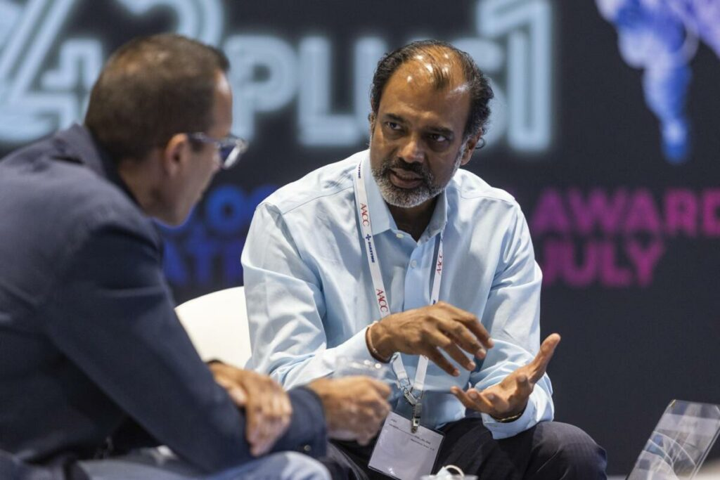
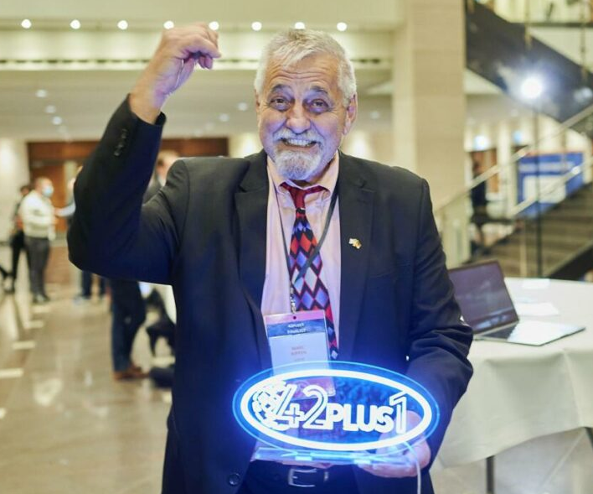
42PLUS1
Win up to $2 million in funding for your startup
42PLUS1 is an exclusive pitch competition dedicated to startups that are active in the diagnostics, digital health, precision medicine & life science tools space, with up to $2 million in funding available for our winners.
All applicants have their business plans reviewed by at least a dozen investors or industry executives. We compile their feedback so every 42PLUS1 participant understands how their pitch compares to other applicants.
Our eight finalists will compete live on stage at this year’s DxPx U.S. to take home the grand prize. Even for participants who don’t make it to the finals, you’re likely to be contacted directly by interested investors and corporate players to explore financing and other business opportunities.
The 42PLUS1 pitch competition serves to open doors for startups looking for investors for their next financing round.

Slide 10
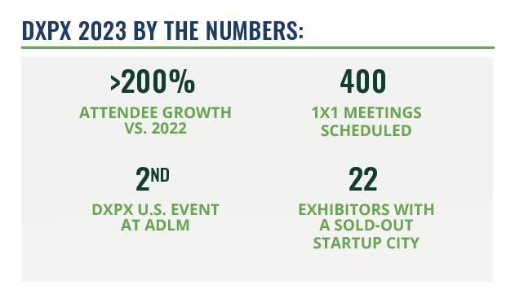

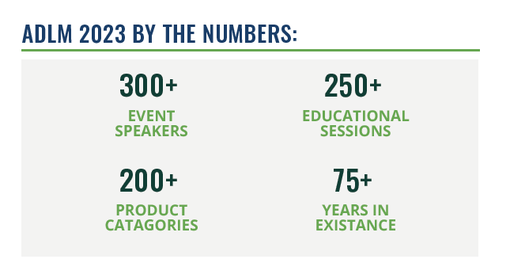

2023 BY THE NUMBERS

Slide 11



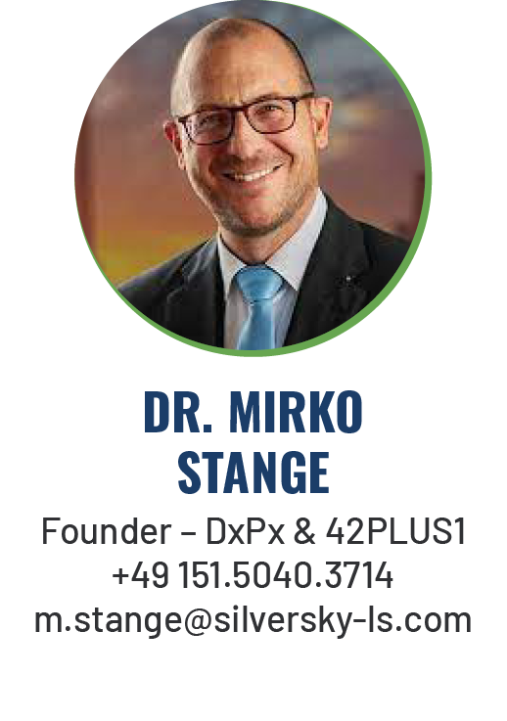
Join Us in Chicago this July

